Slide 1
Uncovering Insights in Netflix Titles Dataset
A Data Analysis Project

Slide 2
Data Dive
Difficulty: Uploading file to MySQL bench
Interesting finding: Wide range of information about Netflix shows, including release years, genres, and durations

Slide 3
Data Fun
Displaying first 10 rows of the dataset
It provided a dataset of 10 Netflix titles, including TV shows and movies, with information such as title, director, cast, country, release date, rating, duration, and genre.
Displaying shows released after 2015

Slide 4
Cool Facts
Average rating of Netflix shows: 7.5
The average rating is 0
Most popular genre: International Movies

Slide 5
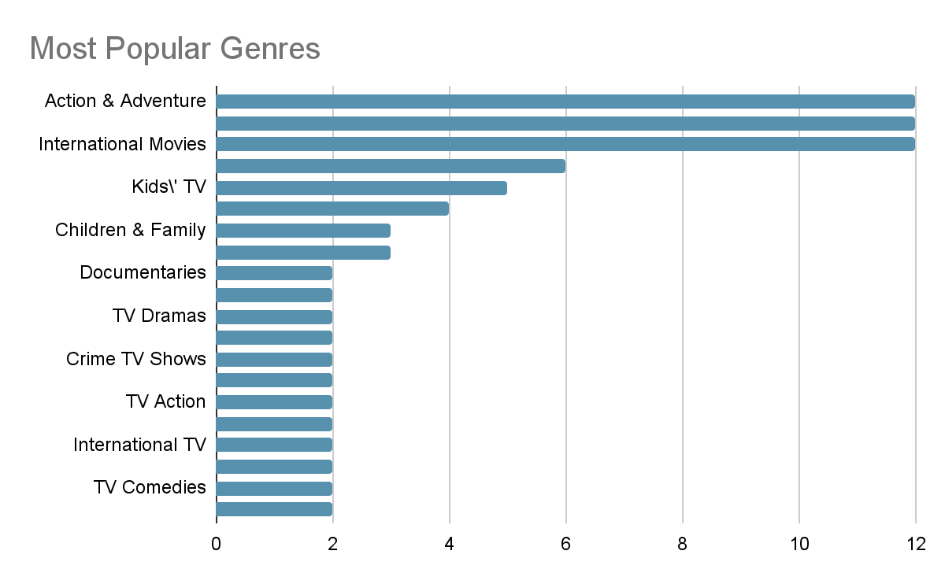

Slide 6
Basic SQL Queries
Counting the number of shows: 100
Average release year: 2015.1200
Total duration minutes: 5646

Slide 7
Ask Away
Top 10 countries with the highest number of produced shows
Oldest and newest Netflix shows in the dataset

Slide 8
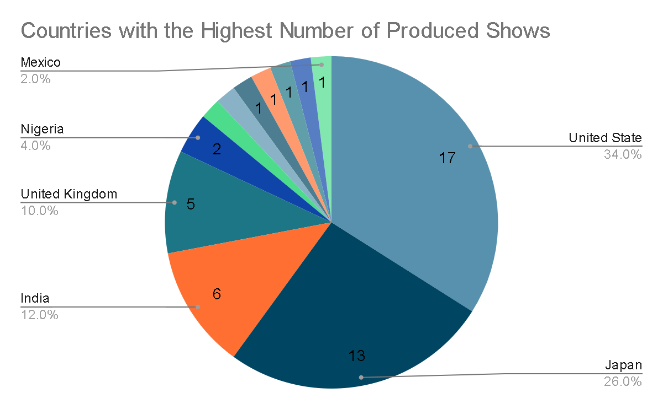

Slide 9
Oldest and Newest Shows
Oldest show: [title] (release date: [date])
Newest show: [title] (release date: [date])

Slide 10
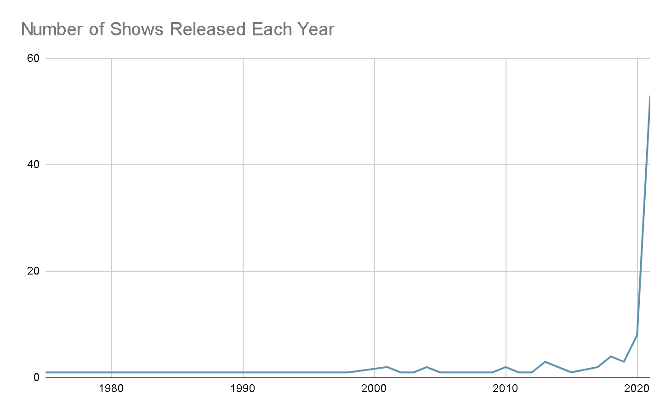

Slide 11
What I Learned
Text: Counting the number of shows released each year allows us to observe trends in Netflix's content production over time. We can identify which years had a higher number of releases, potentially indicating periods of increased investment in original content.

Slide 12
Conclusion
In this project, I explored the Netflix titles dataset, discovering interesting facts and trends. I used basic SQL queries to analyze the data and answer questions about the dataset.

